Slide 1



EDUp FORDCS V1.0 Project Plan
Vienna, April.2022
F
Compendium
FORDSC Project
Edu Platform
v2022.04
MSc. Ömer Karacan
karacankos@gmail.com
Template v2022.04

Slide 2
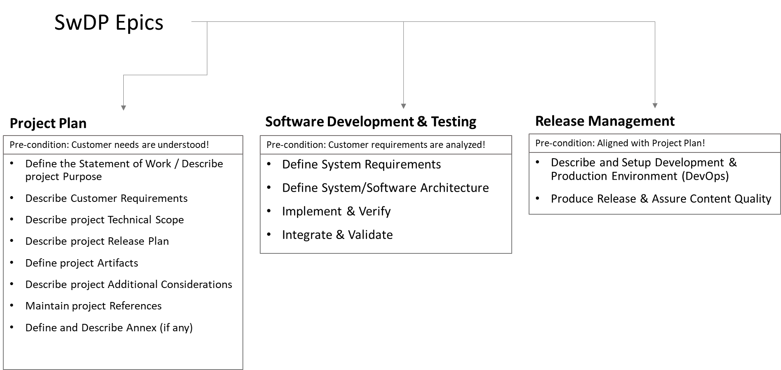
SwPD Method Epics - Setting Copy
Source: EDUp-Full-Stack-Software-Project-Development-Method.pptx

Slide 3
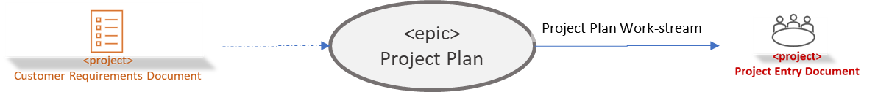
Context

Slide 4
Statement of Work / Purpose
To implement and test the FORDCS V1.0 Software based on customer requirements and Swagger API design!
The Software implementation and testing should be done on premise
The Software acceptance test should be conducted on Azure Cloud!

Slide 5
Customer Requirements
The customer requirements are defined in a set of slides!
EDUp-FORDCS-V1.0 Customer-Requirements-v2022.04.pptx
The FORDCS V1.0 API is designed by a Swagger API!
The app should offer a Swagger document API!
The app should be deployed to Azure Cloud!
The acceptance test should be conducted while app is running on Azure Cloud!

Slide 6
Project Technical Scope

Slide 7
Project Release Plan
The project plan has three main work-streams:
System/Software Development Lifecycle based on the .
PI
SDLC
Artifact(s)
RelDev
Artifact(s)
PM
Artifact(s)

Slide 8
PI
V1.0
R
ToDo
Epic:1
Artifact
Epic:1
Artifact
Epic:1
Artifact

Slide 9










FORDCS-V1.0 Project Artifacts
<project>
Customer Requirements Document
<project>
Test Code
Project Setup Work-stream
FORDCS-V1.0
EDUp FORDCS-V1.0 Project-v2022.04
FORDCS-V1.0
EDUp-FORDCS-V1.0 Customer-Requirements-v2022.04.pptx
<project>
Validation Test Specification
<project>
System Requirements Specification
Acceptance Test Work-stream
<project>
Test Code
Requirements Analysis Work-stream
<project>
Validation Test Specification
<project>
Test Code
<project>
System Requirements Specification
System Test Work-stream
Test Code Work-stream
<project>
Architecture Design Specification
Architecture Design Work-stream
DevOps Document
<project>
Architecture Design Specification
<project>
Validation Test Specification
<project>
DevOps Document
Integration Test Work-stream
DevOps Work-stream
<project>
Component Code
<project>
Verification Test Specification
Implementation Work-stream
<project>
Component Code
<project>
Test Code
Unit Test Work-stream
<project>
Product Release
Cycles
Delivery Work-stream
Text Template: <artifact-name> work-stream)

Slide 10
Additional Considerations

Slide 11
Project References
[SAFe] … https://www.scaledagileframework.com/agile-product-delivery/

Slide 12
<Annex - > <topic name>>

Slide 13
Project Glossary

Slide 14
IDEA: funnel template is a check-list!
roles are important
customer deivers only the use cases --> customer req doc
assumption: customer has not technically profonde knowledge over the FORDCS
WHO is customer? SmartCity Gov!!??!!
EDUp is the supplier, has knowledge about the FORDCS
EDUp sys-req contains req-analysis based on use-use-cases --> state machine models and swagger design --> (analysis phase)
swagger design is input for validation test spec
Project STORY : Analysis design dev -- devops -- test : Dev Life-Cycle Story & PM story (work-funnels)

Slide 15
Backyard

Slide 16
EDUp Project Story Stream Checklist
The < project-name>
Customer Scope
Define the system boundaries
Define the scope of the customer needs/requirements
Describe the needs from the viewpoint of customer (use case, swagger-UI, UX, big-picture)
Define the customer's knowhow profile
Supplier (Project) Scope
Define the system requirements from the viewpoint of supplier (describe with the means of Supplier's technology, tools, ..., HW/SW big-picture)
Define the supplier's knowhow profile
Define a project roadmap (project timeline)
Create artifacts according to EDUp-Full-Stack-Software-Project-Development-Method.pptx
See slide “Full-Stack Software Project Development Method” (#4)
Define the sys/sw-architecture covering the sys-req component-wise (SOA, component-based arch, domain model)
Define alternative solutions and references
Define the components based on Spring architecture
Define DevOps (the dev-env and dev-ops)
Define V&V-spec and -env
Define Deployment (deliverables, release content and media)

Slide 17
EDUp Project Story Stream
00
00
00
00
Customer Scope
00
00
00
00
Supplier Scope
User Scope

